Slide 1
IPL Data Analytics
B.Tech F.Y.
Division - H Batch - 3 Group – H9
46-12010504-Ganesh Karode
47-12011084-Omkar Karpe
48-12010914-Kartik Rupauliha
49-12010397-Kartik Rajput
50-12011421-Nakul Kasar
Course Project
Computing with Python
Department of Engineering, Sciences and Humanities (DESH)
Vishwakarma Institute of Technology, Pune
A.Y.(2020-2021) Term II

Slide 2
OUTLINE
Introduction
problem statement
objectives and aim
background
Implementation
Results and discussion
Conclusion and Future Scope
References

Slide 3
Introduction
Indian Premier League (IPL) is a professional Twenty20 cricket league, contested by eight teams based out of different Indian cities.
After the start of IPL, Indian cricket standards reached an ultimate level and many talented players got a chance to prove themselves in a platform like IPL where many international cricketers play together.
The league was founded by BCCI in 2007 and is now the most attended cricket league in the world and ranks sixth among all sports league.

Slide 4
problem statement
This analysis of IPL data from 2008 to 20120 is done using python packages like numpy, pandas, matplotlib, seaborn and plotly. This Exploratory Data Analysis will help us to find patterns in data, determining relationships in data. We will try to identify the team with most number of wins, players with maximum runs, bowlers with maximum wickets along with many other easy to understand similar analytics.

Slide 5
objectives and aim
objectives
Providing an in-depth statistical details of batting, bowling and fielding along with fixtures, results and team standings.
Also providing team specific records and individual player stats and vital records.
aim
Our aim is developing a GUI based IPL data Analyzer which will have a simple interface and would show analyzed IPL data in an easy to understand form and assess performances of different teams and players over the years in different seasons of The IPL.

Slide 6
background
IPL Data Analysis and Visualization Project using Python from machinelearningknowledge.ai where the programmer has explored interesting insights from the data of IPL matches like most run by a player, most wicket taken by a player, and much more from IPL Season 2008-2020.
Analyzing IPL Data to begin Data Analytics with Python from towardsdatascience.com shows how to get started with different python libraries such as numpy, pandas, matplotlib and seaborn. It shows various analysis such as total number of matches, maximum winning margin, season with most number of matches etc.
Limitations/Challenges
Collecting data itself will be an arduous task. Since we will be taking different entities, discovering the relationships between them and what kind of conclusions we get from these relationships is a really interesting yet tiring challenge that we faced.
Result
After completion of our project, we would be able to give a detailed analysis of data from IPL in form of various charts, plots and graphs which will help us assess the performances of different teams and players over the years.

Slide 7
Implementation
Category of the project
Data Analytics
Tools / Platform
Python 3.9
Front end-Backend Software Requirement
Spyder
Jupyter Notebook

Slide 8
Implementation (Cont.)
Modules / Features
Simple, easy to use GUI.
Able to analyze
Most successful team in IPL.
Maximum runs scored by players and teams.
Maximum wickets taken.
Player with most man of the match awards.
Umpires standing in maximum number of matches.
Cities which hosted most number of matches.
Players who have bowled most number of overs etc.

Slide 9
Implementation (Cont.)
System Architecture (Block Diagram):
IPL Data Analytics
Getting .csv file of ipl
Google-> Kaggle.com-> ipl dataset -> download
Opening .csv file in excel
Data arrangement
Opening Spyder ide
importing .csv file from excel in ide
Performing analysis using python
Using matplotlib, NumPy, pandas for data visualizations
Data Visualization
Fig.1 Block Diagram

Slide 10
Implementation (Cont.)
Overall Algorithm
We start by downloading the ipl dataset csv file(.csv)
Further the data from this file is processed and split into required format in excel.
Data-frame is created from this sorted output using pandas in Spyder IDE.
Once the file is loaded in IDE using Pandas various operations can be performed over it using Python.
Data is visualized from this data-frame using matplotlib, pyplot, NumPy, seaborn, etc.

Slide 11
Implementation (Cont.)
Overall Flowchart
Collect Dataset
Import library
Import Dataset
Matches.csv
deliveries.csv
Analysis data of Teams
Analyzing Data from .csv files
Analysis data of Players
Most times win player of the match
No. of times Toss wins
No. of Matches played
Batsman
Bowlers
No. of times Toss wins
No. of matches win
Most Runs
Most wickets
Most Sixes
Most times bowled the batsman
Winning percentage
Most Fours
Most extra runs given
Fig.2 flowchart result

Slide 12
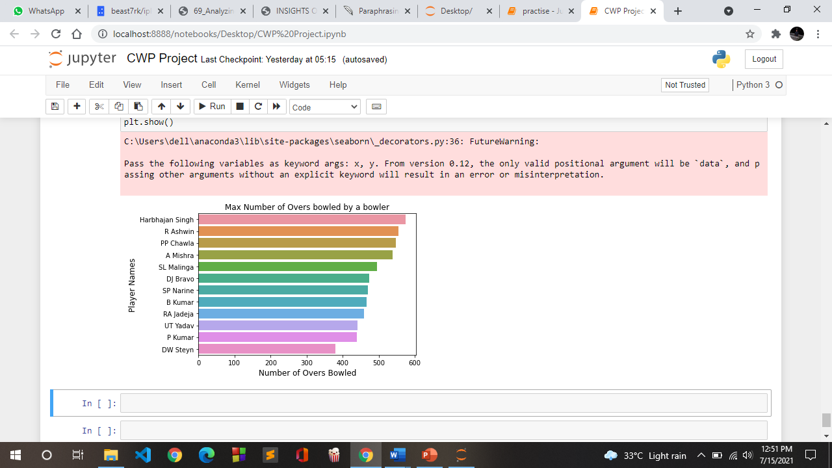
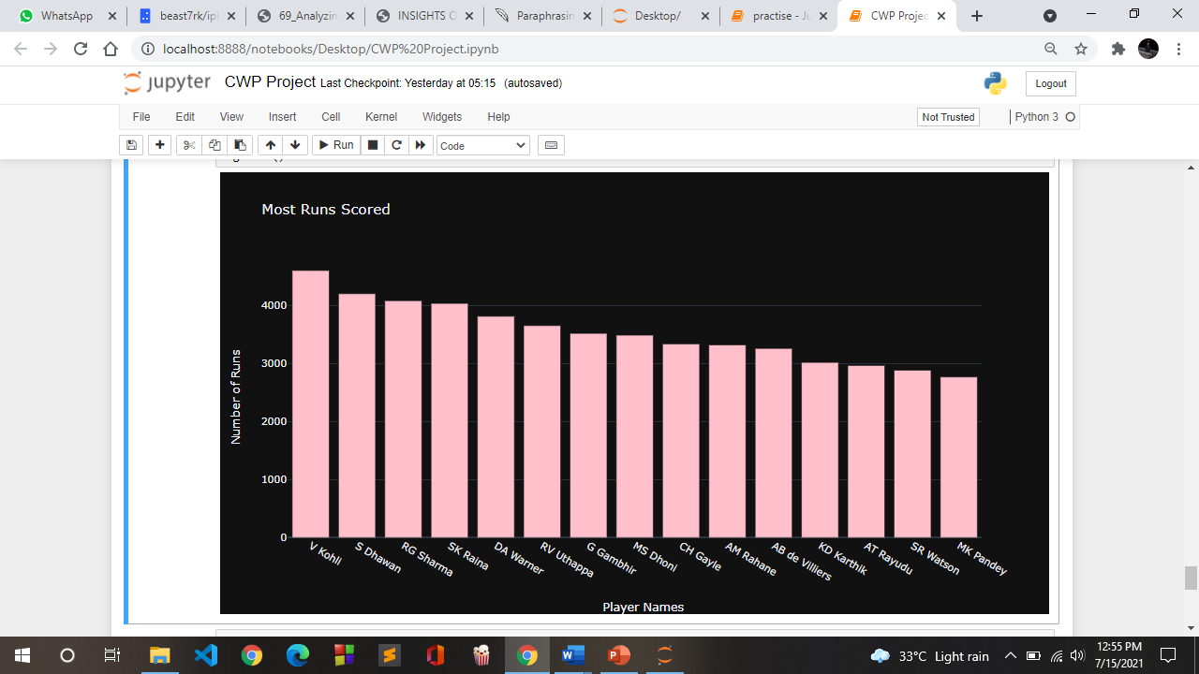
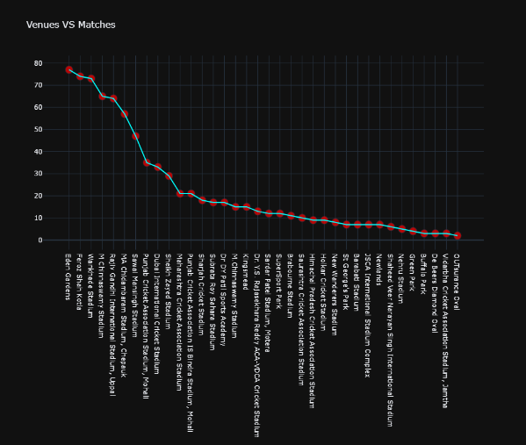
Results and discussion
The following represents the output of the result of the analysis done with Python on the ipl dataset.
Fig3.
Fig4.
Fig5.
This screenshot shows the top 15 maximum run scorers in The IPL.
This screenshot shows the top 12 bowlers with maximum number of overs bowled.
This screenshot shows which venue has hosted the most number of IPL matches.

Slide 13
Conclusion and Future Scope
Conclusion
In the paper we focus on IPL team data from various years.WE analyzed performance of various teams and players.
Various factors such as most successful team, most runs, role of toss in winning, overall performance were considered while analyzing.
The results of the study could be used to make future judgements for teams and players.
Future Scope
we can further combine project eith machine learning and predict match winner according to past performances this can be also used different media to get better knowledge of ipl teams performance

Slide 14
Contribution
Div. H Batch 3 Group H9
Roll No 46-12010504-Ganesh Karode
IPL individual player data analytics for year 2015-2016
Roll No 47-12011084-Omkar Karpe
IPL team data analytics for year 2015-2019
Roll No 48-12010914-Kartik Rupauliha
IPL individual player data analytics for year 2019-2020
Roll No 49-12010397-Kartik Rajput
WhatsApp Data Analytics
GUI
Roll No 50-12011421-Nakul Kasar
IPL individual player data analytics for year 2017-2018

Slide 15
References
1 .Youtube tutorial Data Analytics with python by freecodecamp.
2. machinelearningknowledge.ai
3. towardsdatascience.com
4. Kaggle.com
5. GeeksForGeeks.com
6. w3schools.com

Slide 16
Thank You

